Slide 1

FORRT
Framework for Open and Reproducible Research Training
Neurodiversify your Curriculum
Unconference
Virtual | March 10th, 2023

Slide 2

What is FORRT?
Established in 2018
Ever-growing community of more than 700 scholars and educators in fields such as Psychology, Neuroscience, Communication science, Linguistics, Economics, Medicine, Computer science, Philosophy, Political science etc.
Notes:
So, what is FORRT? FORRT is an organization that started in 2018 in discussion of the Society for Improvement of Psychological Science. In the last 3 years, the organization has profoundly increased, counting today with more than 246 scholars (mostly ERC) in different academic fields and disciplines.

Slide 3
What are FORRT goals?
Build together with educators a pathway towards the incremental adoption of open scholarship practices into higher education
Generate a conversation about the ethics and social impact of a higher-education pedagogy that emphasizes openness, epistemic uncertainty and research credibility
Promote a reflection about the perceived importance of different academic activities and advocate for greater recognition of educational resources
Notes:
FORRT’s main goal is to build, together with educators, a path towards the incremental adoption of principled teaching and mentoring practices.
FORRT also aims to generate a conversation about the ethics and social impact of a higher-education focused on openness, epistemic uncertainty and research credibility.
Finally, FORRT also responds to calls to consider open scholarship as inclusive scholarship. FORRT tries to promote a discussion about the perceived importance attributed to different academic activities (for example, think of how research tends to be overvalued to the detriment of teaching) and advocate for greater institutional recognition of educational resources.

Slide 4
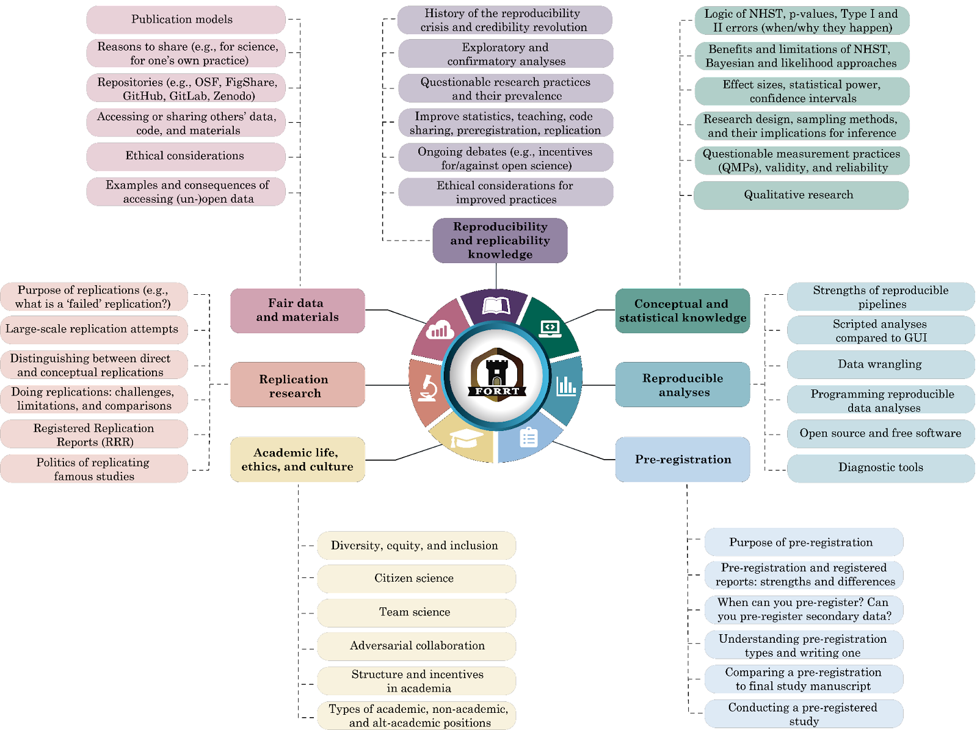
Notes:
We have identified 7 clusters. Each cluster is further broken down into sub-categories to provide educators with useful information on the extent of open scholarship, and topics connected to one another.

Slide 5
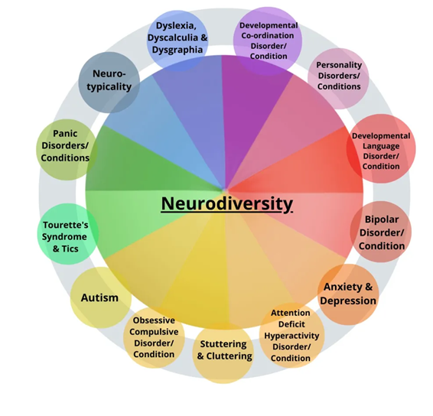
FORRT #TeamNeurodiversity
Neurodiversity is the non-pathological variation in the human brain regarding sociability, learning, attention, mood and other mental functions (Armstrong, 2014)
Neurodiversity has received little or no attention within Open Scholarship discussions
Aims to raise awareness of diversity in academia, build community and increase the visibility of the work produced by neurodivergent scholars and educators

Slide 6
FORRT Shared Values
Neurodiversity & Open Scholarship movements
Social justice
Equity of opportunity
Collaborative team approaches, drawing on individuals’ strengths

Slide 7
FORRT
"Neurodiversifying” the Open Scholarship curriculum
1. Raising awareness of neurodiversity
2. Talking about difference openly and with empathy
3. Delivering for a diverse student audience
Workshop accompanied by a Lesson Pack: https://msgrose-hodge.github.io/ND/

Slide 8

FORRT 1. Raising Awareness
Representation of neurodivergent scholars
Including papers by neurodivergent researchers in reading lists
Database of Neurodivergent Researchers
Creating a safe environment for disclosure by staff and students
Notes:
https://docs.google.com/spreadsheets/d/1OnfQB1OqC00OflwTuRPBhG5NfX-_oLxxoTM_F_J5t5c/edit#gid=699666261

Slide 9
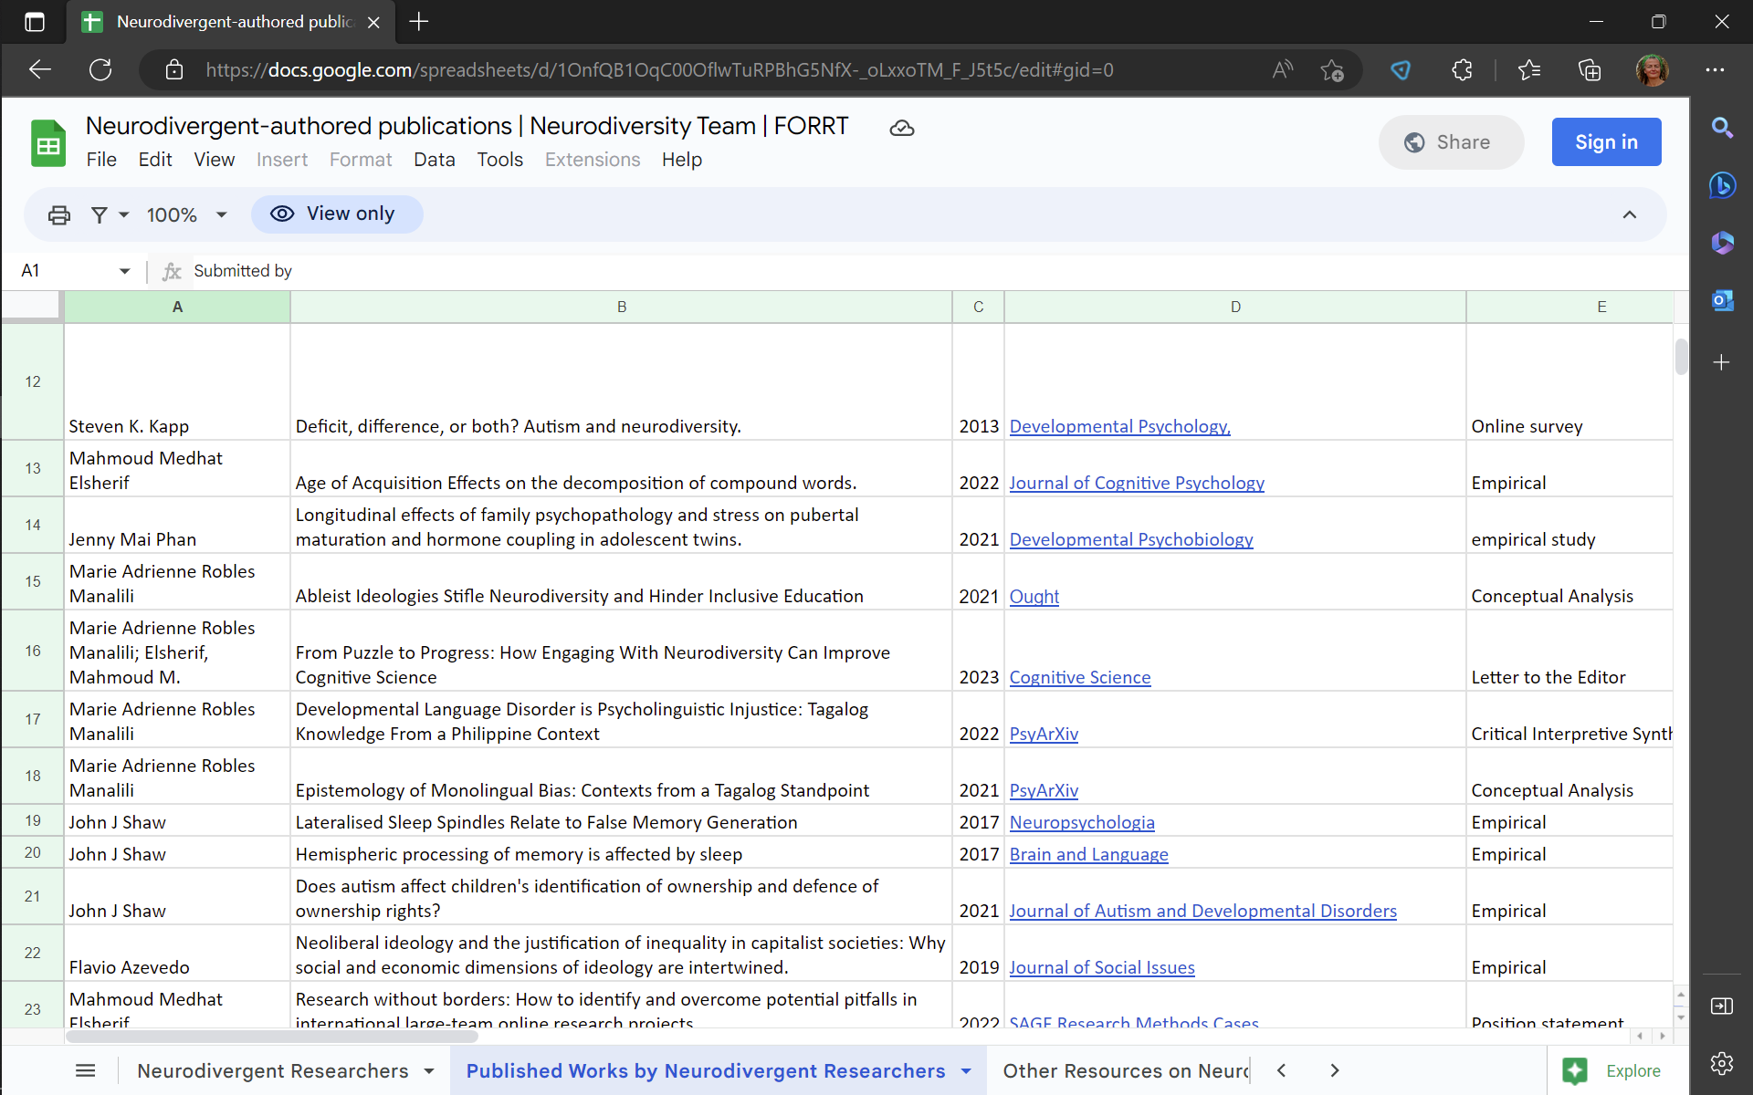



Slide 10
FORRT 1. Raising Awareness
Challenging the deficit focus
“Deficits” in… | Can mean strengths in…
Perseveration | Persistence
Big picture thinking | Attention to detail
“Restricted” interests | Deep funds of knowledge
Sustained attention | Creativity
Response inhibition | Fast problem solving/ decision making

Slide 11
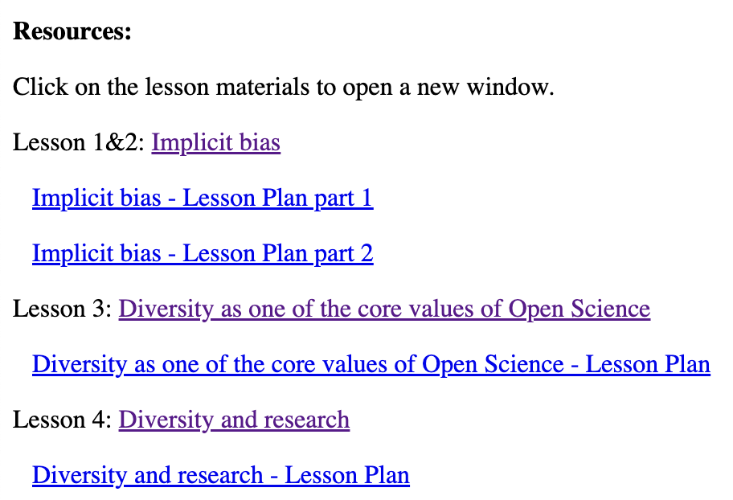
FORRT 1. Raising Awareness
Example activity from FORRT resource pack: Recognising bias in academic texts (Lesson 1: Implicit Bias, Activity 1)
Skim the article by Lombroso (1903). What beliefs did the author hold about the following:
men /women / white people / people of races other than white / children / left-handed individuals / individuals suffering from mental health problems / individuals with criminal record?
click to see text
Notes:
https://msgrose-hodge.github.io/ND/h5p-standalone-1.3.x/demo/content-example-2.html
https://msgrose-hodge.github.io/ND/implicitbias.html

Slide 12
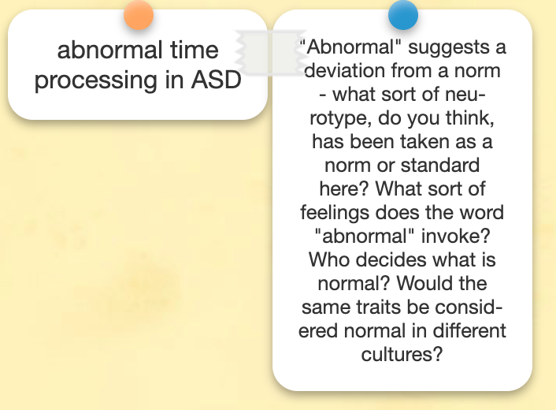
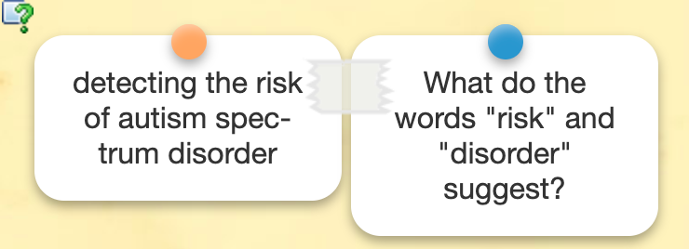
FORRT 1. Raising Awareness
CHALLENGING THE DEFICIT APPROACH: analysing language used in recent scientific papers - https://learningapps.org/watch?v=pi3j02pkt23
Lesson 1: Implicit Bias Activity 5.
Notes:
https://learningapps.org/watch?v=pi3j02pkt23
https://msgrose-hodge.github.io/ND/implicitbias.html

Slide 13
FORRT 2. Talking about Diversity
Creating an environment of trust
Mindful use of language; avoiding discriminatory or pathologising terminology
Awareness of, and willingness to overcome, double empathy barriers in the classroom
Modelling respect for minorities

Slide 14
FORRT 2. Talking about Diversity
Bottema-Beutel et al., (2021)
Potentially ableist? | Alternative | Potentially ableist? | Alternative
Special needs | Description of specific needs | Co-morbid | Co-occurring
Challenging/ problem behaviour | Meltdown/ stimming/ description of specific behaviour | Symptoms | Traits/ characteristics
Person-first language “person with autism” | Identity-first language “autistic person” | Treatment | Support services
Low/high functioning | Describe specific strengths & needs | Psychopathology | Neurodevelopmental condition
Notes:
https://psyarxiv.com/3vjnq – Natri et al. (2023)

Slide 15
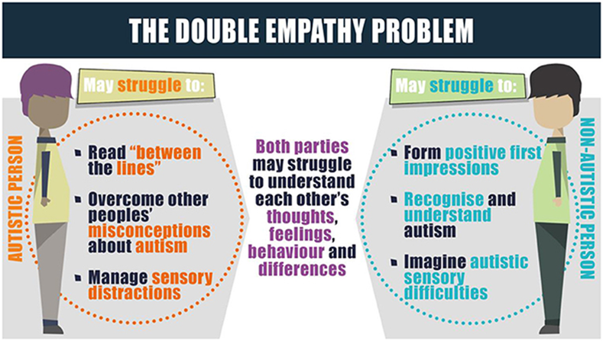
FORRT 2. Talking about Diversity
Milton (2012); Crompton et al. (2021)

Slide 16
FORRT 2. Talking about Diversity
Double empathy barriers in the classroom
Neuro-normative expectations of participation and engagement in class
Assumption of bad intentions behind neurodivergent behaviours
Stereotyped expectations of neurodivergent learning abilities

Slide 17
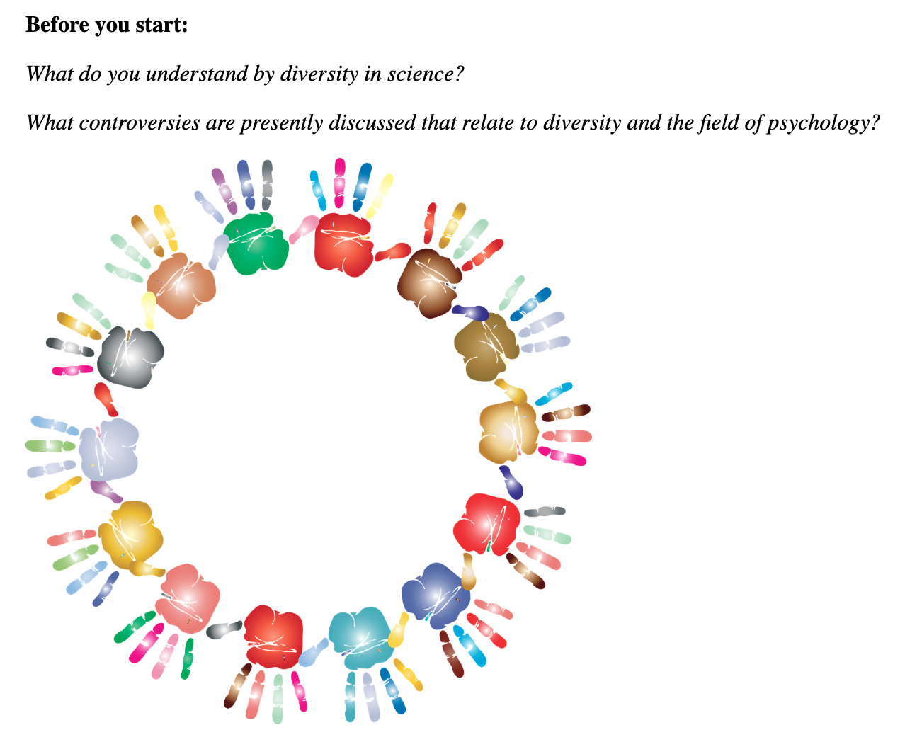
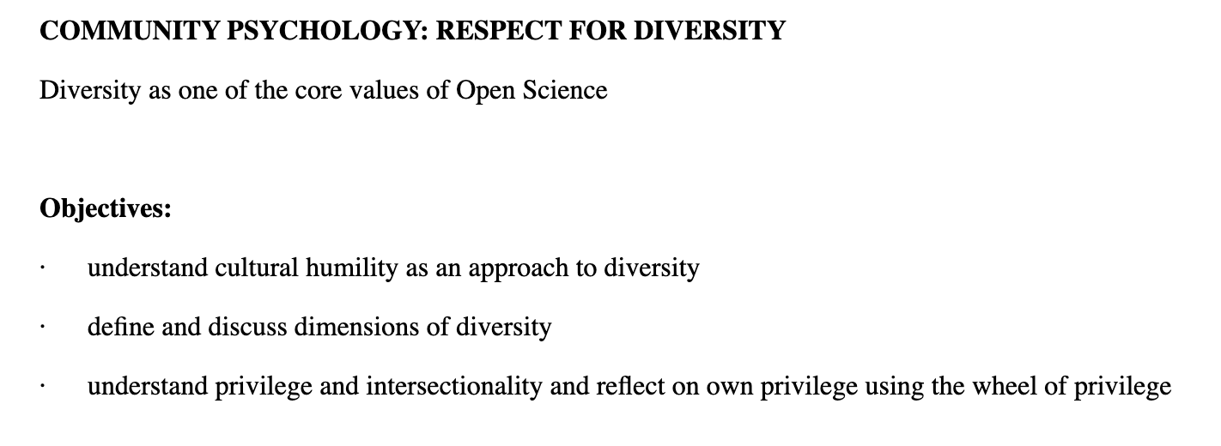
FORRT 2. Talking about diversity
Linked lesson plan
Lesson 3: Diversity as one of the core values of OS, Activity 4 - link
Notes:
https://msgrose-hodge.github.io/ND/Community%20Psychology%20-%20Diversity.html

Slide 18
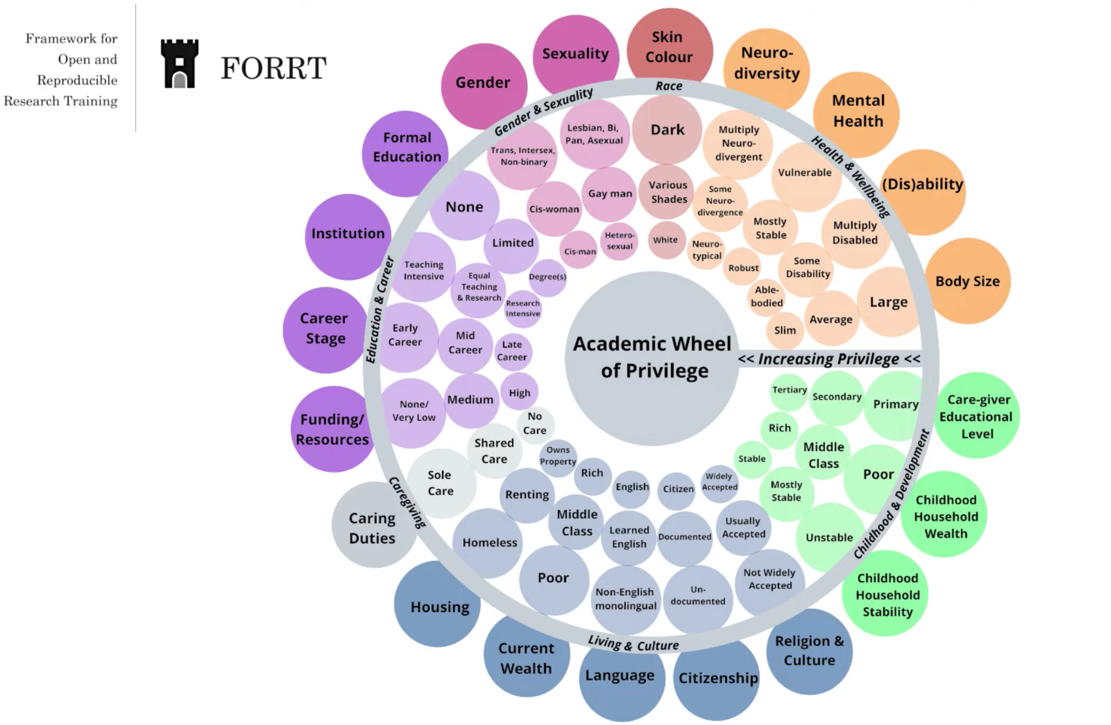
How to use the wheel: Look at the dimensions of privilege on the outside of the circle and choose the option from the inner circle that describes your situation best. For every answer in the smallest circle (the closest to the middle of the wheel), give yourself 1 point, then 2 points for the option in a slightly bigger circle and finally 3 points for the option closest to the outside of the circle.

Slide 19
FORRT 3. Delivering for Diversity
Harnessing neurodiversity-affirmative pedagogies
Strengths-based approaches
Social justice pedagogy
Compassionate pedagogy
Universal Design for Learning

Slide 20
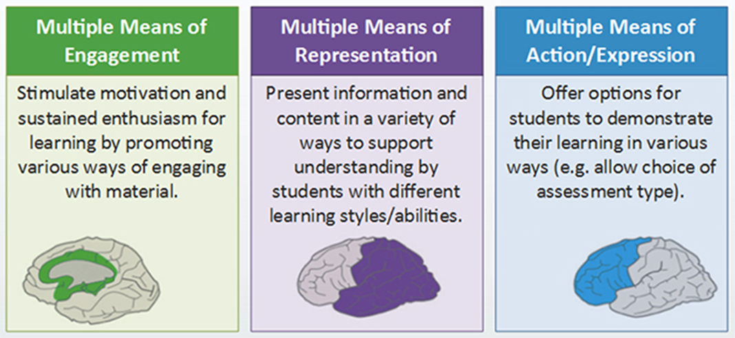
Universal Design for Learning (UDL)
Embedded choice, autonomy & flexibility
CAST (2018)

Slide 21
FORRT 3. Delivering for Diversity
Choice: Lesson 3: Respect for Diversity, Activity 2 link
Now choose the task you prefer to get a better understanding of the concepts presented above.
JIGSAW READING (group activity)
a) In groups, decide who is going to focus on the points below while skimming through the text in order to summarise it to the rest of the group. Once you decide how to divide the sections, spend 10-15 minutes reading through the relevant parts and preparing to summarise the concepts to your students.
CREATING A MIND MAP OR A POSTER
b) Skim through the chapter and create a mind map or a poster with dimensions of diversity and quick explanations. Then add information about cultural humility, privilege and intersectionality. Share the results of your work with another student.
Notes:
https://msgrose-hodge.github.io/ND/Community%20Psychology%20-%20Diversity.html

Slide 22
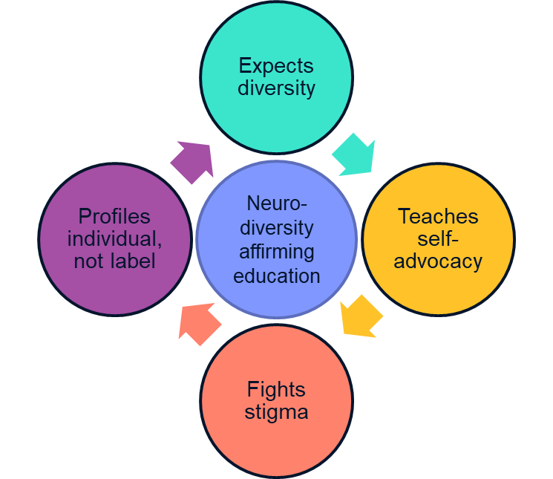
FORRT Neurodiversity-affirming education

Slide 23
Discussion points:
What easy solutions / strategies could you think of that would help ALL students to manage their time better?
Can you think of a time when you had a conflict / misunderstanding which could be caused by double empathy barriers? How could you approach a similar situation taking the Neurodiversity Paradigm into consideration?
Think of a lesson or course you have developed - think of 3 ways in which it could be neurodiversified.

Slide 24
Further Reading from #TeamNeurodiversity
Elsherif M. M., Middleton S. L., Phan J. M., Azevedo F., Iley B., Grose-Hodge M., et al.. (2022). Bridging neurodiversity and open scholarship: How shared values can guide best practices for research integrity, social justice, and principled education. Preprint. https://doi.org/10.31222/osf.io/k7a9p
Hamilton, L.G., & Petty, S. (2023). Compassionate pedagogy for neurodiversity in higher education: A conceptual analysis. Frontiers in Psychology, 14. https://doi.org/10.3389/fpsyg.2023.1093290

Slide 25




Thank you!
https://forrt.org
forrtproject@gmail.com
@FORRTproject
https://forrt.org/publications/
Notes:
So, I would like to conclude by saying that FORRT has many other initiatives, so please check our website if you are interested in discovering more initiatives and pedagogies and follow us on twitter for more updates. I would also encourage you to have a look at our publication page in case you would like to read our more recent publications on open scholarship and open educational resources.
In addition, we always welcome and appreciate new members at any career stage and from any discipline who are interested in open scholarship. If this presentation caught your interest and attention, please join our community in our slack channel. We would be happy to have you! Thank you very much for your attention and if there are any questions, please feel free to email us.

Slide 26
References
Bottema-Beutel, K., Kapp, S.K., Lester, J.N., Sasson, N.J., & Hand, B.N. (2021). Avoiding ableist language: Suggestions for autism researchers. Autism in Adulthood, 3(1), 18-29. https://doi.org/10.1089/aut.2020.0014
CAST (2018). UDL and the Learning Brain. Available at: https://www.cast.org/products-services/resources/2018/udl-learning-brain-neuroscience
Crompton, C.J., DeBrabander, C., Heasman, B., Milton, D., & Sasson, N.J. (2021). Double empathy: Why autistic people are often misunderstood. Frontiers for Young Minds, 9. https://doi.org/10.3389/frym.2021.554875
Milton, D.E.M. (2012). On the ontological status of autism: The ‘double empathy problem’. Disability & Society, 27(6), 883-887. https://doi.org/10.1080/09687599.2012.710008

